Slide 1
Data and Application Integration Techniques
SE495: Software and Systems Integration

Slide 2
Outline
Data integration: ETL, ELT, and data virtualization
Application integration: point-to-point, hub-and-spoke, and hybrid
Adapters and connectors
Data transformation and mapping
Data and application integration challenges and best practices

Slide 3
Data integration: ETL, ELT, and data virtualization

Slide 4
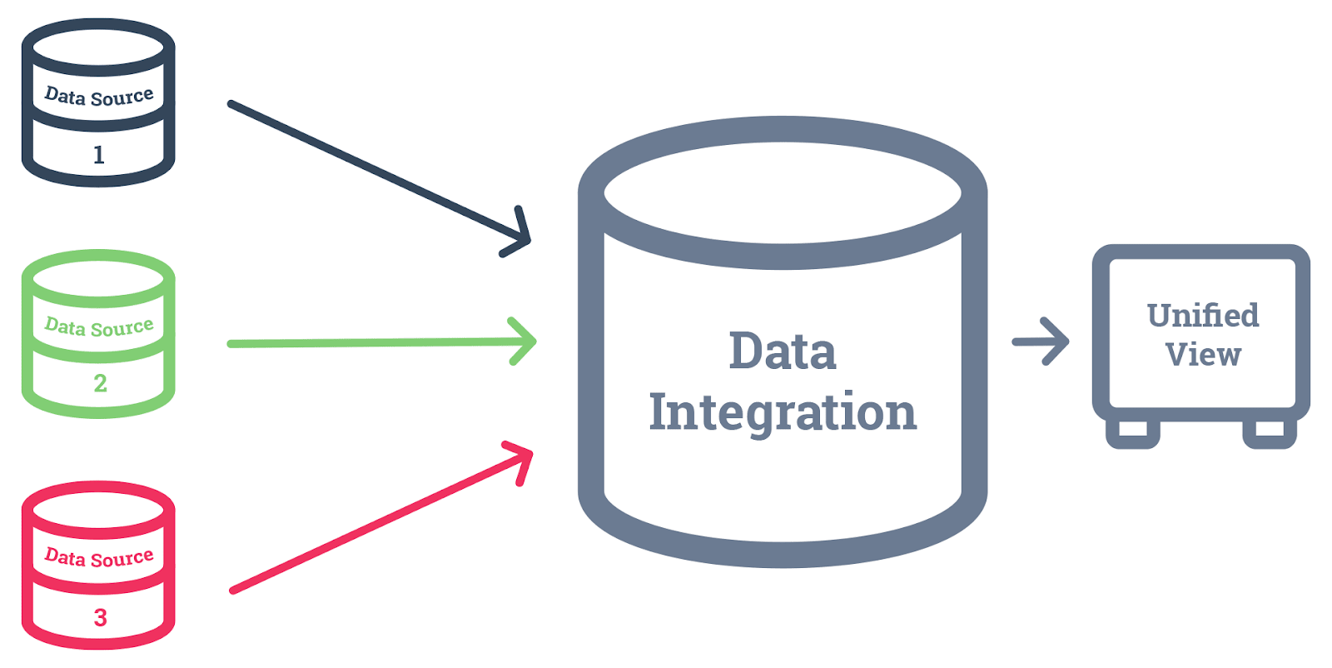
Data Integration
Data integration is the process of combining data from multiple sources into a unified view for analysis and decision-making.
ETL, ELT, and data virtualization are three common techniques used for data integration.

Slide 5
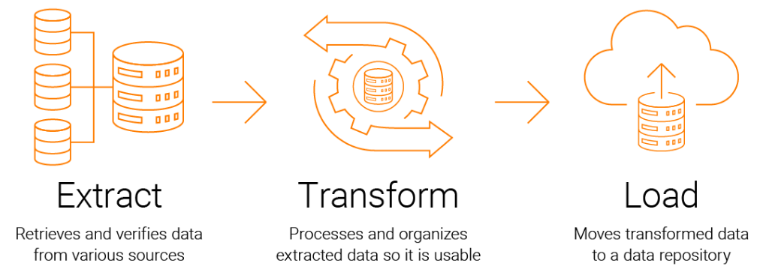
ETL (Extract, Transform, Load)
ETL is a batch-oriented process that involves extracting data from source systems, transforming it to meet the target system's requirements, and loading it into the target system.
Extract, transform, load (ETL) is a three-step process for moving data from one or more sources into a single destination.

Slide 6
ETL (Extract, Transform, Load)
The three steps are:
Extract
The first step is to extract the data from the source. This can be done using a variety of tools, such as SQL queries, ETL tools, or data scraping tools.
Transform
The second step is to transform the data. This may involve cleaning the data, removing duplicates, or converting it into a different format.
Load
The third step is to load the data into the destination. This can be done using a variety of tools, such as SQL queries, ETL tools, or data loading tools.

Slide 7
ETL (Extract, Transform, Load)
Advantages: ETL is effective for large volumes of data and can handle complex transformations.
Disadvantages: ETL is time-consuming and may not be suitable for real-time data integration.

Slide 8
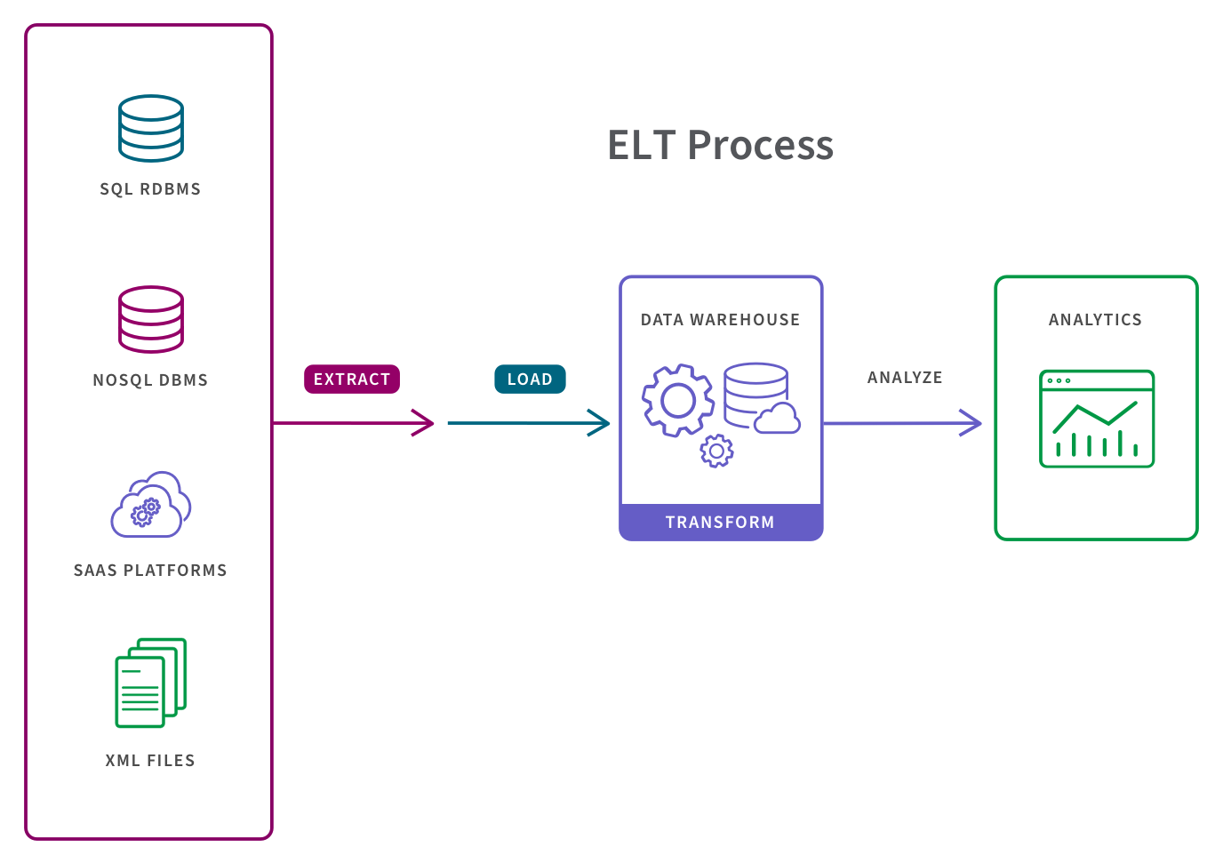
ELT (Extract, Load, Transform)
ELT is a process that extracts data from source systems, loads it into the target system, and then transforms it in the target system.
Extract, load, transform (ELT) is a data integration process that is an alternative to the traditional extract, transform, load (ETL) process.

Slide 9
ELT (Extract, Load, Transform)
This process consists of three steps:
Extract
This step works similarly in both ETL and ELT data management approaches. Raw streams of data from virtual infrastructure, software, and applications are ingested either in their entirety or according to predefined rules.
Load
Here is where ELT branches off from its ETL cousin. Rather than deliver this mass of raw data and load it to an interim processing server for transformation, ELT delivers it directly to the target storage location. This shortens the cycle between extraction and delivery.
Transform
The database or data warehouse sorts and normalizes the data, keeping part or all of it on hand and accessible for customized reporting. The overhead for storing this much data is higher, but it offers more opportunities to mine it for relevant business intelligence in near real-time.

Slide 10
ELT (Extract, Load, Transform)
ELT has a number of advantages over ETL, including:
Speed
ELT can be faster than ETL because the transformation is not performed until the data is in the target system.
Flexibility
ELT is more flexible than ETL because the transformation can be performed in the target system, which may have more powerful transformation capabilities than the source system.
Cost
ELT can be less expensive than ETL because the transformation is not performed in the source system, which may require more expensive software.

Slide 11
ELT (Extract, Load, Transform)
Advantages: ELT is faster than ETL and can handle real-time data integration.
Disadvantages: ELT may not be suitable for complex transformations, and the target system must have the necessary processing power.

Slide 12
Data Virtualization
Data virtualization is a technique that creates a virtual layer between the source and target systems, allowing the data to be accessed and integrated without physically moving it.
Data virtualization is a technology that creates a single, logical view of data from multiple, disparate sources.
This allows users to access and analyze data from different sources without having to know the physical location or format of the data.

Slide 13
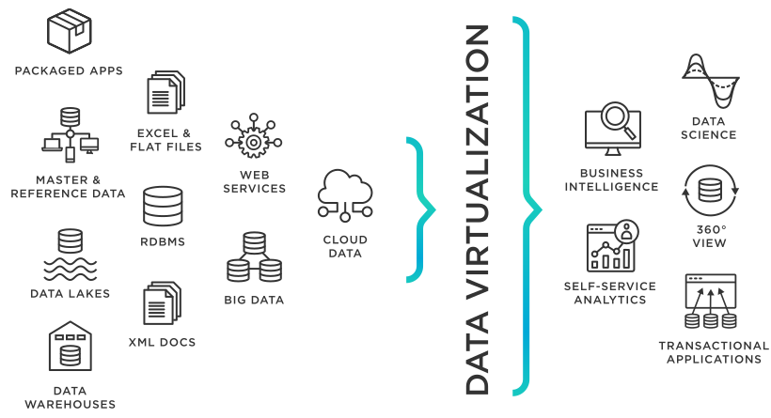
Data Virtualization
Data virtualization can be used to solve a variety of data integration challenges, including:
Heterogeneous data sources
Data silos
Data security
Data governance

Slide 14
Data Virtualization
Advantages: Data virtualization is flexible, agile, and can handle real-time data integration. It can also reduce duplication of data.
Disadvantages: Data virtualization may not be suitable for handling large volumes of data or complex transformations.

Slide 15
Tools
ETL | ELT | Data Virtualization
Talend (O and P) Apache NiFi (O) Microsoft SQL Server Integration Services (P) Oracle Data Integrator (P) IBM InfoSphere DataStage (P) Pentaho Data Integration (O) Apache Kafka (O) Google Cloud Dataflow (P) AWS Glue (P) | Oracle Data Integrator (P) Microsoft Azure Data Factory (P) Talend Big Data (P) Apache NiFi (O) Apache Spark (O) Apache Hive (O) AWS Glue (P) Google Cloud Dataflow (P) IBM Cloud Pak for Data (P) | Denodo (P) Red Hat JBoss Data Virtualization (P) Cisco Data Virtualization (P) IBM Cloud Pak for Data (P) TIBCO Data Virtualization (P) Apache Calcite (O) DataVirtuality (P) Microsoft SQL Server PolyBase (P) SAP HANA Smart Data Integration (P)

Slide 16
Application integration: point-to-point, hub-and-spoke, and hybrid

Slide 17
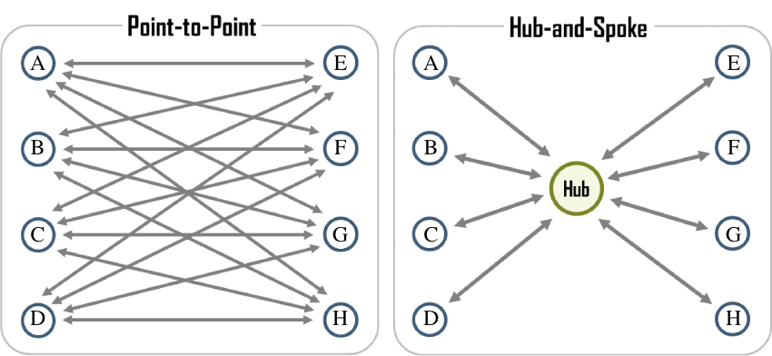
Introduction
Application integration is the process of connecting different applications and systems to work together seamlessly.
Point-to-Point, Hub-and-Spoke, and Hybrid are three common techniques used for application integration.

Slide 18
Point-to-Point Integration
Directly connecting two systems together
Simple and straightforward, but can become complex and difficult to manage as the number of systems increases
Custom interfaces and protocols are used to connect systems
Can be used for small-scale integrations or temporary solutions

Slide 19
Point-to-Point Integration
Point-to-Point integration is a direct connection between two applications without any intermediary system.
Applications are connected using custom code or APIs.
Advantages: Point-to-Point integration is simple, fast, and can be used for small-scale integrations.
Disadvantages: Point-to-Point integration can become complex and difficult to manage as the number of applications increases.

Slide 20
Hub-and-Spoke Integration
Hub-and-Spoke integration involves a central system (the hub) that connects to several applications (the spokes).
The hub acts as an intermediary system that provides routing, transformation, and other integration services.
Hub-and-spoke integration is a type of integration architecture where multiple systems are connected to a central hub.
The hub acts as a mediator between the systems, and it is responsible for routing data between them.

Slide 21
Hub-and-Spoke Integration
Hub-and-spoke integration is often used when there are a large number of systems to integrate, or when the systems are not compatible with each other.
It is also a good solution for businesses that need to ensure data security and compliance.
Advantages: Hub-and-Spoke integration is scalable, manageable, and can handle complex integrations.
Disadvantages: Hub-and-Spoke integration can be expensive to set up, andthere is a single point of failure with the hub.

Slide 22
Hybrid Integration
Hybrid integration combines Point-to-Point and Hub-and-Spoke integration techniques.
Some applications are connected directly using Point-to-Point integration, while others are connected through a central hub.
It is often used when there are a large number of systems to integrate, or when the systems are not compatible with each other.
Hybrid integration can offer the best of both worlds, by providing the flexibility of point-to-point integration and the scalability of hub-and-spoke integration.

Slide 23
Hybrid Integration
Advantages: Hybrid integration is flexible and can handle both simple and complex integrations.
Disadvantages: Hybrid integration can be more complex to manage than Point-to-Point integration.

Slide 24
Examples
Point-to-Point Integration Example
An example of Point-to-Point integration is connecting a web application to a database using a custom API.
The web application sends requests to the database through the API, and the database responds with the requested data.
Point-to-Point integration can be used for small-scale integrations where only a few applications need to be connected.

Slide 25
Examples
Hub-and-Spoke Integration Example
An example of Hub-and-Spoke integration is connecting multiple applications to a central ERP system.
The ERP system acts as the hub, providing integration services such as data transformation and routing.
The spokes (applications) connect to the hub using standard protocols such as REST or SOAP.

Slide 26
Examples
Hybrid Integration Example
An example of Hybrid integration is connecting a web application to a payment gateway through a central hub.
The web application sends payment requests to the central hub, which then routes the requests to the appropriate payment gateway using Point-to-Point integration.
The hub also provides data transformation and other integration services as needed.
Hybrid integration can be used for complex integrations where some applications require direct connections, while others can be connected through a central hub.

Slide 27
Adapters and connectors

Slide 28
Adapters and Connectors
Adapters and connectors are software components that enable data and application integration by providing a standardized interface between different systems and applications.
They are used to connect different systems and applications, regardless of their underlying technology.
This allows businesses to share data and applications across different systems, which can improve efficiency and productivity.

Slide 29
Adapters
Adapters are software components that enable different applications and systems to communicate with each other.
Adapters act as a bridge between different systems, providing a standardized interface for data exchange.
They can be used to connect a variety of different systems, including:
Relational databases
NoSQL databases
File systems
Web services
Enterprise application integration (EAI) platforms
Cloud-based applications

Slide 30
Adapters
Adapters can be used to perform a variety of different tasks, including:
Extracting data from one system and loading it into another
Transforming data from one format to another
Sending notifications when data is updated
Enabling users to interact with multiple systems from a single interface
Advantages: Adapters are flexible, reusable, and can handle different data formats and protocols.
Disadvantages: Adapters can be complex to configure and manage, and may require maintenance and updates over time.

Slide 31
Connectors
Connectors are software components that enable applications to connect to different data sources.
Connectors provide a standardized interface for data access, allowing applications to retrieve, manipulate, and store data from different sources.
Advantages: Connectors are flexible, reusable, and can handle different data formats and protocols.
Disadvantages: Connectors can be complex to configure and manage, and may require maintenance and updates over time.

Slide 32
Types of Adapters
There are different typesof adapters used for data and application integration, including:
Database adapters: enable applications to connect to and manipulate data in different databases.
Messaging adapters: enable applications to communicate with different messaging systems, such as JMS or MQTT.
Web service adapters: enable applications to consume and publish web services using different protocols, such as SOAP or REST.
File adapters: enable applications to read and write files in different formats, such as CSV or XML.

Slide 33
Types of Connectors
There are different types of connectors used for data and application integration, including:
JDBC connectors: enable applications to connect to different databases using the JDBC API.
ODBC connectors: enable applications to connect to different databases using the ODBC API.
REST connectors: enable applications to consume and publish REST APIs.
SOAP connectors: enable applications to consume and publish SOAP web services.
File system connectors: enable applications to read and write files in different formats, such as CSV or XML.

Slide 34
Adapters and Connectors in Middleware
Middleware is a software layer that sits between different systems and applications, providing integration services.
Adapters and connectors are often used in middleware to enable data and application integration.
Middleware platforms such as MuleSoft and IBM Integration Bus provide a range of built-in adapters and connectors.

Slide 35
Adapters and Connectors in Cloud Integration
Cloud integration platforms such as Microsoft Azure and AWS offer a range of adapters and connectors for data and application integration.
These platforms provide pre-built adapters and connectors for common systems and applications, as well as the ability to create custom adapters and connectors.
Cloud integration platforms also provide scalability, reliability, and security for data and application integration.

Slide 36
Tools
MuleSoft Anypoint Platform (Pre-built connectors)
IBM Integration Bus (Built-in adapters and connectors)
Oracle Integration Cloud Service (Pre-built adapters)
Dell Boomi (Pre-built connectors)
Apache Camel (Pre-built connectors)
SnapLogic (Pre-built connectors)
Jitterbit (Pre-built connectors)

Slide 37
Summary
Adapters and connectors are software components that enable data and application integration by providing a standardized interface between different systems and applications.
Adapters act as a bridge between different systems, while connectors enable applications to connect to different data sources.
There are different types of adapters and connectors used for data and application integration, including database adapters, messaging adapters, web service adapters, and file adapters.

Slide 38
Summary
Adapters and connectors are often used in middleware and cloud integration platforms to provide integration services.
Adapters and connectors provide flexibility, reusability, and the ability to handle different data formats and protocols.
However, they can be complex to configure and manage, and may require maintenance and updates over time.
Ultimately, the goal of adapters and connectors is to enable different systems and applications to work together seamlessly to support business operations and decision-making.

Slide 39
Data transformation and mapping

Slide 40
Data Transformation
Data transformation is the process of converting data from one format or structure to another.
Data transformation can involve changing data types, renaming fields, filtering data, and aggregating data, among other things.
This can be done for a variety of reasons, such as:
To make the data more compatible with a different system or application
To improve the quality of the data by removing errors or inconsistencies
To make the data more useful for analysis or reporting

Slide 41
Data Transformation
Some of the most common data transformation techniques include:
Data cleaning
Data integration
Data normalization
Data mining
Advantages: Data transformation enables different systems and applications to share data in a standardized format, reducing the risk of errors or inconsistencies.
Disadvantages: Data transformation can be complex and time-consuming, and may require specialized skills or tools.

Slide 42
Types of Data Transformation
There are different types of data transformation used for data and application integration, including:
Data type transformation: converting data from one data type to another, such as converting a string to a number.
Data format transformation: converting data from one format to another, such as converting CSV data to XML data.
Data aggregation: combining data from multiple sources into a single dataset, such as combining sales data from different stores into a single report.
Data filtering: removing or selecting specific data based on criteria, such as selecting all customers from a specific region.
Data enrichment: adding additional data to existing data, such as adding demographic information to customer data.

Slide 43
Data Transformation Examples
An example of data transformation is converting date and time data from one format to another.
For example, converting a date and time field in the format "MM/DD/YYYY HH:MM:SS" to the format"YYYY-MM-DDTHH:MM:SSZ".
Another example is converting currency data from one currency to another, such as converting USD to EUR.
The data transformation process involves applying a conversion formula or lookup table to the data.

Slide 44
Mapping
Mapping is the process of defining the relationship between data elements in different systems or applications.
Mapping enables data to be transferred between systems or applications in a way that preserves its meaning and context.
Data mapping is an essential part of any data integration project.

Slide 45
Mapping
There are two main types of data mapping:
Physical data mapping: This type of mapping identifies the physical location of data in the data sources. This is typically done by identifying the table names, column names, and data types of the fields in each data source.
Logical data mapping: This type of mapping identifies the logical meaning of the data in the data sources. This is typically done by identifying the business entities and attributes of the data.
Advantages: Mapping ensures that data is transferred accurately and correctly between systems or applications.
Disadvantages: Mapping can be complex and time-consuming, and may require specialized skills or tools.

Slide 46
Mapping Examples
An example of mapping is mapping customer data from a CRM system to an ERP system.
The mapping process involves defining the relationship between fields in the two systems, such as mapping the customer name field in the CRM system to the customer name field in the ERP system.
Another example is mapping inventory data from a warehouse management system to an e-commerce platform.
The mapping process involves defining the relationship between fields in the two systems, such as mapping the product ID field in the warehouse management system to the product ID field in the e-commerce platform.

Slide 47
Tools
There are a number of tools available for data transformation and mapping. Some of the most popular tools include:
Talend Open Studio for Data Integration
IBM InfoSphere DataStage
Oracle Data Integrator
Microsoft SSIS
SAP Data Services

Slide 48
Data and application integration challenges and best practices

Slide 49
Data Quality
Data quality is a common challenge during data and application integration.
Poor data quality can result in errors, inconsistencies, and incorrect decisions.
Best practices for addressing data quality issues include:
establishing data governance policies,
implementing data validation and cleaning processes, and
conducting regular data audits.

Slide 50
Data Security
Data security is a critical concern during data and application integration.
Data breaches can result in financial losses, reputational damage, and legal liability.
Best practices for addressing data security issues include:
implementing data encryption,
user authentication, and access controls, as well as
conducting regular security audits.

Slide 51
Data Governance
Data governance is the process of managing data quality, security, and compliance.
Data governance ensures that data is used appropriately and consistently across different systems and applications.
Best practices for data governance include:
establishing data ownership and stewardship,
defining data standards and policies, and
implementing data governance tools and processes.

Slide 52
System Compatibility
System compatibility is a common challenge during data and application integration.
Different systems and applications may use different data formats, protocols, and interfaces, making it difficult to exchange data.
Best practices for addressing system compatibility issues include:
using standardized data formats and protocols,
implementing middleware and integration platforms, and
conducting thorough system compatibility testing.

Slide 53
Scalability
Scalability is a challenge during data and application integration, especially as data volumes and system complexity increase.
Inadequate scalability can result in performance issues, system outages, and data loss.
Best practices for addressing scalability issues include:
using cloud-based integration platforms,
implementing distributed architectures, and
conducting load testing.

Slide 54
Change Management
Change management is a challenge during data and application integration, as changes to one system or application can have a ripple effect on other systems and applications.
Poor change management can result in system downtime, data loss, and customer dissatisfaction.
Best practices for change management include:
establishing change management processes,
conducting impact analysis before making changes, and
implementing version control and rollback procedures.

Slide 55
Case Study: Healthcare Industry
Overview
In this case study, we'll explore how a large hospital network implemented data and application integration techniques to improve patient care, streamline workflows, and enhance collaboration among medical professionals.
The hospital network consists of multiple hospitals, outpatient clinics, and specialized medical centers. Prior to integration, various departments and facilities used disparate software systems to manage patient records, schedules, billing, and other essential information.

Slide 56
Case Study: Healthcare Industry
Challenge
The hospital network faced several challenges, including:
Inefficient data exchange between different software systems, leading to delays in patient care, billing, and reporting.
Inability to access a comprehensive view of patient data, limiting the ability of medical professionals to make informed decisions.
Time-consuming manual processes for transferring and reconciling data between systems, leading to potential errors and inconsistencies.

Slide 57
Case Study: Healthcare Industry
Solution
The hospital network decided to implement a data and application integration solution to address these challenges.
The solution involved the following key components:
Enterprise Service Bus (ESB) (Facilitate communication and exchange data in a standardized format)
APIs (seamless data exchange between the ESB and different software systems)
Data Transformation and Mapping
Master Data Management (MDM) (Single, accurate source of truth for patient data)
Business Process Automation

Slide 58
Case Study: Healthcare Industry
Results
The implementation of the data and application integration solution led to several key benefits for the hospital network, including:
Improved Patient Care
Increased Efficiency
Enhanced Collaboration
Reduced Errors
Scalability

